Slide 1
Dr.R.Jeberson Retna Raj Department of IT, School of Computing, Sathyabama Institute of Science and Technology
Unit-IV : OBJECT ORIENTED DESIGN

Slide 2
UNIT 4 OBJECT ORIENTED DESIGN
Object Oriented Design Process - Object Oriented Design Axioms - Corollaries - Designing Classes: Object Constraint Language - Process of Designing Class - Class Visibility - Refining Attributes - Access Layer: Object Store and Persistence - Database Management System - Logical and Physical Database Organization and Access Control- Distributed Databases and Client Server Computing - Object Oriented Database Management System – Object Relational Systems - Designing Access Layer Classes - View Layer: Designing View Layer Classes - Macro Level Process - Micro Level Process - Purpose of View Layer Interface - Prototyping the user interface.

Slide 3
Introduction
Object oriented system development
Object oriented analysis – use case driven
Object oriented design
Prototyping
Component based development
Incremental testing

Slide 4
Background – OO Analysis
Identify classes
Noun phrase approach
Common class pattern approach
Use case driven sequence / collaboration modeling approach
Classes, Responsibilities and collaborators (CRC) approach
Identify the attributes, methods
Identify the relationship between objects
Association
Super-sub structure (also known as generalization)
Aggregation and a-part-of structure.

Slide 5
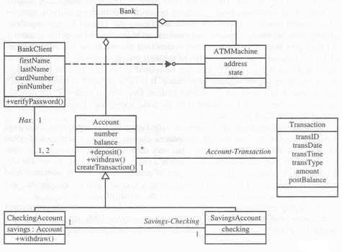
Analysis – ViaNet Bank

Slide 6
Introduction – Design phase
Goal : Design the classes, attributes and methods.
Relate model into real world physical domain
Good design simplifies the implementation and maintenance of the project.
Design is focus on view and access classes.
Axioms used to formalize the design process.
Provide fundamental basis for the creation of the system.

Slide 7
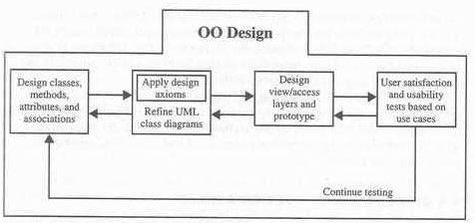
Object Oriented Design Process

Slide 8
Object Oriented Design Process
Apply design axioms to design classes, attributes, methods and associations.
Design the access layers.
Design view layer classes.
Iterate and refine the whole design
Design must be traceable across requirements, analysis, design, code and testing.

Slide 9
Object Oriented Design Process
1. Apply design axioms to design classes, attributes, methods and associations.
1.1 Refine UML class diagram
Refine attributes
Design methods – UML activity diagram.
Refine association between classes
Refine class hierarchy and design with inheritance
1.2 Iterate and refine again.

Slide 10
Object Oriented Design Process
2. Design the access layers.
2.1 Create mirror classes
2.2 Identify access layer class relationships.
2.3 Simplifies classes and their relationships
Redundant classes
Method classes
2.4 Iterate and refine again

Slide 11
Object Oriented Design Process
3 Design the view layer classes
3.1 Design the macro level user interface
3.2 Design the micro level user interface
Design the view layer object
Build a prototype of view layer interface.
3.3 Test usability and user satisfaction
3.4 Iterate and refine

Slide 12
Object oriented design axioms
Axioms – fundamental truth, valid
Axiom 1 : Independent Axiom ( maintain the independence of components.
Each component must satisfy the requirements without affecting other component requirements.
Axiom 2 : Information Axiom (minimize the information design of the content)
Simplicity – minimum amount of complexity and maximum level of simplicity
Use inheritance and systems built-in classes

Slide 13
Corollaries
Corollary – proposition that follows from an axioms
Design rules derived from two axioms.
Corollary -1 : Uncoupled design with less information content.
Corollary -2 : Single purpose
Corollary -3 : Large number of simple classes
Corollary -4 : Strong mappings
Corollary -5 : Standardization
Corollary -6 : Design with Inheritance

Slide 14
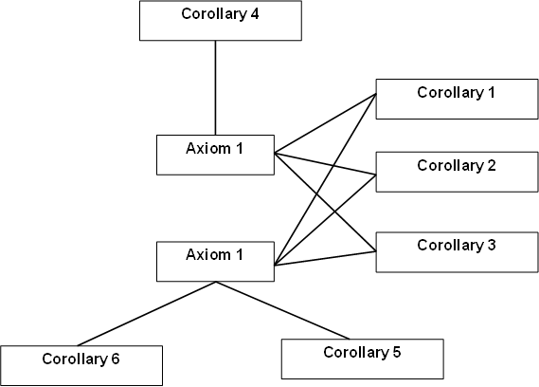
Corollaries

Slide 15
Corollary -1 Uncoupled design with less information content.
Coupling : coupling is a measure of the strength of association established by a connection from one object to another.
Coupling is a binary relationship.
Change to one component makes minimal impact on other component.
Strong coupling among objects complicates a system.
Coupling increases with increasing complexity of the interface.
A good software will have low coupling.

Slide 16
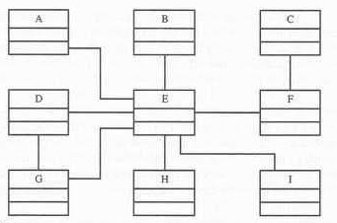
E is tightly coupled object
Any changes to one leads to a ripple effect of changes in others.
The degree of coupling between component is measured by the amount and complexity of information transmitted between them.

Slide 17
Interaction coupling
OOD has two types of coupling
Interaction coupling
Inheritance coupling
Interaction coupling involves the amount of complexity of messages between components.
It is desirable to have little interaction.
Guideline : keep the messages as simple and infrequent as possible.

Slide 18
Interaction coupling
Degree of coupling | Name | Description
Very high | Content coupling | Connection involves direct reference to attributes or methods of another object
High | Common coupling | Two objects accessing global data space for both to read and write
Medium | Control coupling | Control of processing logic of one object by another
Low | Stamp coupling | Passing aggregate an data structure to another object
Very low | Data coupling | Either simple data item or aggregate structure of whose elements are used by receiving object.

Slide 19
Inheritance coupling
Coupling between super and sub classes
A sub class is coupled with its super class in terms of attributes and methods.
High inheritance coupling is desired.
Specialization class should not inherit unrelated and unneeded methods and attributes

Slide 20
Cohesion
Deals with interaction within a single objects or software components.
Cohesion supports classes that have very specific goals and defined purposes (single purposness of object)
Highly cohesive components can lower coupling.
because only a minimum of essential information need be passed between components.
Cohesion helps in designing classes that have very specific goals and clearly defined purposes.

Slide 21
Object Oriented Design support three kinds of cohesion.
Method cohesion
method should carry only one function.
Class cohesion
Methods and attributes of a class are highly cohesive
Inheritance cohesion
How interrelated are classes
Does specialization really portray specialization

Slide 22
Corollary 2 single purpose
Every class should be clearly defined to achieve system’s goals.
Document a class,
easily explain its purpose in a sentence or two.
If not, divide into more independent classes with purpose.
Keep it simple
More precise
Each method must provide only one service.
Each method described by Half page

Slide 23
Corollary 3 : Large number of simpler classes, Reusability
Smaller the classes, the better you reuse.
Large and complex classes are complicated to be reused.
OOD – aims to reuse the classes rather than build a new one
Levels of reusability – 70 to 80 percent
Why people not promote reusability
s/w books teach to build a product from first principle.
Not invented here syndrome.
Unsuccessful experiences
No reward

Slide 24
Corollary -4 : Strong mapping
A strong mapping links the identified classes during analysis phase to design during design phase.
For Ex. During analysis : Employee class identified.
During design phase : Design Employee class, attributes, methods and association with other objects, view and access classes.

Slide 25
Corollary – 5 : Standardization
It requires good understanding of the classes in the OOPs environment.
Small talk, Java, C++ , PowerBuilder has several built-in class libraries
Class libraries must easily be searched, based on users' criteria
Design patterns capture the design knowledge, document it and store it in a repository that can be shared and reused in different applications.

Slide 26
Corollary 6 : Designing with inheritance
Inheritance : To minimize the amount of program instruction.
Determine the ancestor, attributes, messages of a class.
Construct the methods and protocols of a class.
Single inheritance
Redesign the application by using the inheritance mechanisms supported by the system's target language.
If the language supports single inheritance exclusively, select a formal super class.
Identify other related sub classes and relevant methods.
Advantages of single inheritance
It avoids ambiguity in the selection of methods by a class.
It concentrates only on the specific behavior of an object.

Slide 27
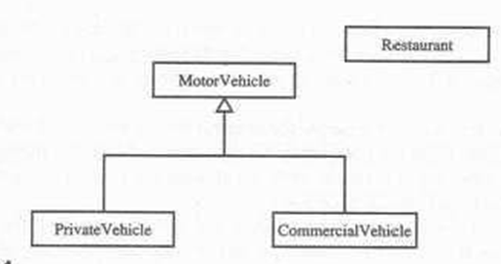
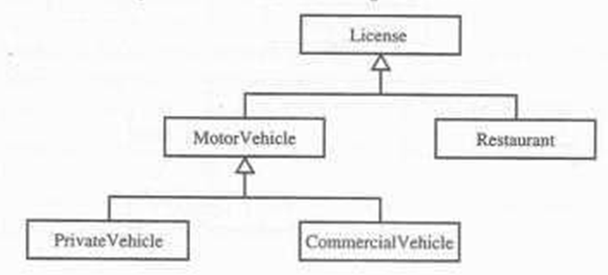
Single Inheritance
Single Inheritance
The class restaurant is inherited

Slide 28
Problem with Multiple Inheritance
Multiple Inheritance in a single inheritance system
LISP and C++ support multiple inheritance
Disadvantages
Several ancestor classes
Which behavior is getting from which class is
It is more difficult to understand programs.
Solution
single inheritance is to inherit from the most appropriate class and add an object of another class as an attribute or aggregation.

Slide 29
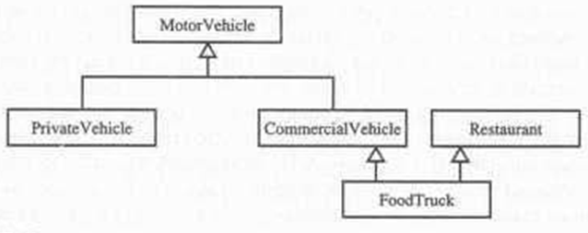
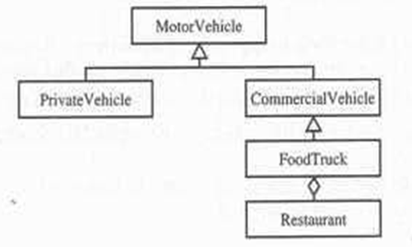
Problem with Multiple Inheritance
Avoiding inheriting inappropriate behavior

Slide 30
Designing Classes
Topics covered
Guidelines and approaches to use in designing classes and their methods.
UML object constraint language

Slide 31
Object constraint Language (OCL)
OCL is a specification language that uses simple logic for specifying the properties of a system.
Many UML modeling constructs require expression.
Expressions are stated as strings in OCL
Item.selector
Example : John.age

Slide 32
Item.selector[qualifier-value]
Ex : John.Phone[2]
Set→select(boolean-expression) : the boolean expression written in terms of objects within the set.
Ex: company.employee→salary>3000
This represents employees with salaries over $3000.

Slide 33
Process of designing class
1. Apply design axioms to design classes, attributes, methods and associations.
1.1 Refine UML class diagram
Refine attributes
Design methods – UML activity diagram.
Refine association between classes
Refine class hierarchy and design with inheritance
1.2 Iterate and refine again.

Slide 34
Class visibility
Designing methods, attributes two problems to be addresses
1.protocol : Public, private and protected
Public protocol – made available to other objects
Private protocol – can be hidden from other objects
Protected protocol – sub classes can use the method in addition to the class itself.
2. encapsulation leakage – occurs when details about a class ‘s internal implementation are disclosed through the interface.

Slide 35
Class visibility
Private protocol (visibility) of a class:
Messages normally should not be sent from other objects
Accessible only to operations of that class.
Public protocol (visibility) :
Defines the behavior is accessible by all classes and subclasses.
Protected protocol(visibility) :
sub classes can use the method in addition to the class itself.

Slide 36
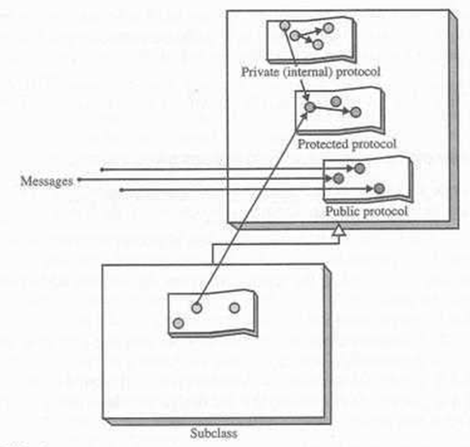
Class visibility

Slide 37
Contn..
Private and protected protocol layer : internal
Items in these layers define the implementation of the object.
Public protocol layer : External
Items in this layer define the functionality of the object.
Good design allows polymorphism
Not all protocol should be public.

Slide 38
Refining attributes
In analysis phase : name of the attribute was sufficient
Design phase : detailed information added to the model.
Goal is refine existing attributes or add attributes
Attribute type
Single value attribute
Multiplicity or multi-value attribute
Reference to another object, or instance connection

Slide 39
Attribute design
Attribute represent the state of an object.
When the state of the object changes, these changes are reflected in the value of attributes.
Single value attribute is most common
Multiplicity or mutivalue attribute collection of many values at any given time.

Slide 40
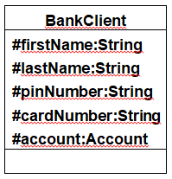
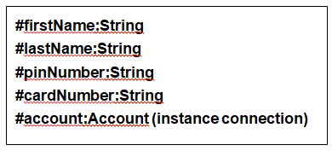

UML attribute presentation
Syntax
Visibility name : type expression=initial value
Where visibility is one of the following:
+ public visibility(accessibility to all classes)
# protected visibility(accessibility to subclasses and operations of the class)
- private visibility (accessibility only to operations of the class)
Visibility name : type expression=initial value
Firstname
Lastname
Pinnumber
Cardnumber

Slide 41
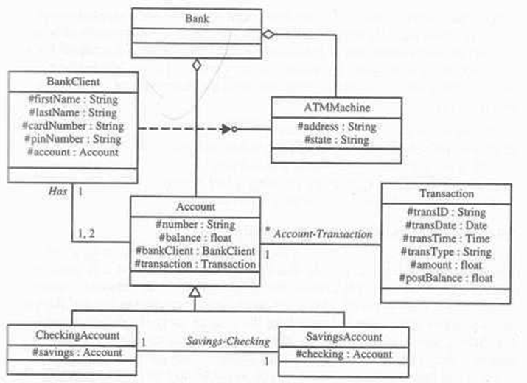
Design of Attributes - ViaNet Bank System

Slide 42
Designing methods
A class can provide several types of method :
Constructor – method that create instance
Destructor –method that destroy instance
Conversion method – converts a value from one unit of measure into another.
Copy method – copy the contents of one instance to another
Attribute set – set value to attribute
Attribute get – returns values of one or more attributes
I/O methods – provide or receive data from device
Domain specific – specific to an application

Slide 43
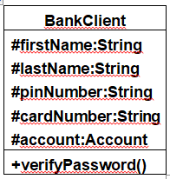
UML operations
Syntax
Where visibility is one of the following:
+ public visibility
# protected visibility
- private visibility
Example
+getName():aName
+getAccountNumber (account :type) : account Number
Visibility name : (parameter list):return-type -expression

Slide 44
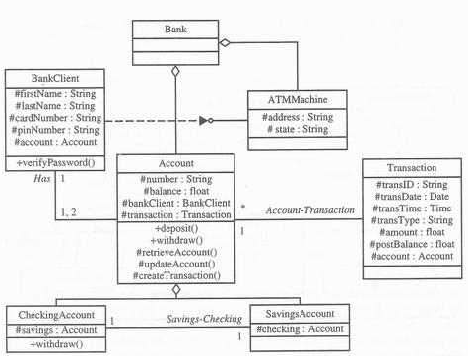
Design view of ViaNet Bank System

Slide 45
Access Layer
A database management system (DBMS) is a collection of related data and associated programs that access, manipulate, protect and manage data.
The main purpose of a DBMS is to provide a reliable, persistent data storage facility, and mechanism for efficient and convenient data access and retrieval.
Persistence (review) –means objects that outlive the programs
Persistent object stores do not support query or interactive user interface facilities

Slide 46
Object Storage and Persistence
six broad categories for the lifetime of data:
Transient results to the evaluation of expressions.
Variables involved in procedure activation (parameters and variables with a localized scope).
Global variables and variables that are dynamically allocated.
Data that exist between the executions of a program.
Data that exist between the versions of a program.
Data that outlive a program.

Slide 47
Object Storage and Persistence
First three categories are transient data and other three are non transient or persistent data.
Programming languages provide excellent and integrated support for first three categories.
Other three categories supported by DBMS or file system.

Slide 48
Database Management Systems
A DBMS is a set of programs that enable the creation and maintenance of a collection of related data.
DBMS have a number of properties that distinguish them from the file-based data management approach.

Slide 49
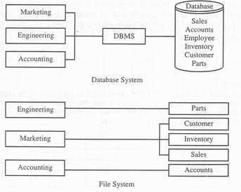
Database system Vs. File System.

Slide 50
Database Models
A database model is a collection of logical constructs used to represent the data structure and data relationships within the database.
Hierarchical Model
Network Model
Relational Model

Slide 51
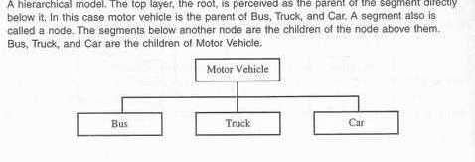
Hierarchical Model
The hierarchical model represents data as a single-rooted tree

Slide 52
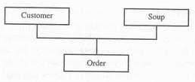
Network model
A network database model is similar to a hierarchical database, with one distinction.
Unlike the hierarchical model, a network model's record can have more than one parent.

Slide 53
Relational Model
Of all the database models, the relational model has the simplest, most uniform structure and is the most commercially widespread.
Column of each table are attributes that defines data.
rows of each table are tuples represents individual data object being stored.
A relational table should have only one primary key.
A primary key is a combination of one or more attributes whose value unambiguously locates each row in the table

Slide 54
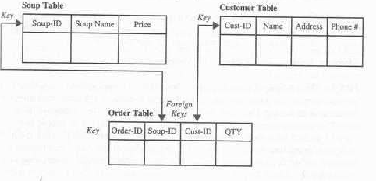

Slide 55
What is a schema and metadata?
The schema, or metadata, contains a complete definition of the data formats, such as the data structures, types, and constraints.
In an object-oriented DBMS, the schema is the collection of class definitions.
The relationships among classes (such as super/sub) are maintained as part of the schema.

Slide 56
Database Definition Language (DDL)
A database definition language (DDL) is used to describe the structure of and relationships between objects stored in a database.
To create logical structure or schema, the following SQL command can be used:
Create schema authorization(creator) create database (database name)
For example
Create table inventory (inventory_number char(10) not null description char[25] price decimal (9,2))

Slide 57
Data Manipulation Language (DML)
DML is the language that allows to access and manipulate (such as create, save or destroy) data organization.
The Structured Query Language (SQL) is the standard DML for relational DBMS.
In a relational DBMS, the DML is independent from a host programming language.
For example, a host language such as C or COBOL would be used to write the body of the application.
SQL statements are then typically embedded in C or COBOL applications to manipulate data.

Slide 58
Logical and Physical Database Organization and Access Control
Logical database refers to the conceptual view of database structure and the relationship within the database. ex. databases
Physical database organization – refers to how the logical components of the database are represented in a physical form.
Ex. Objects represented as files

Slide 59
Sharability and Transaction
Data and objects in a database shared by multiple applications.
Object concurrency - conflicts over object access will arise
Database mediate these conflicts and promote sharing of data.
Mediation process is managed through concurrency policies.

Slide 60
Transaction
A transaction is a unit of change, in which either all changes to objects within a transaction will be applied or not at all.
A transaction is said to commit if all changes can be successfully made to the database.
A transaction is said to abort if all changes cannot be successfully made to the database.

Slide 61
Concurrency policy
Several users (or application) attempt to read and write the same object simultaneously.
Concurrency control mechanism is used to mediate such conflicts, and dictate how it can be handled.
Goal : to provide each user with a consistent view of the database.
This means transaction must occur in a serial order.
Conservative or pessimistic policy : to allow a user to lock all records or objects when they are accessed and to release the locks only after a transaction commits.
Distinguish between object-read lock or write lock

Slide 62
Concurrency policy
This policy allows many readers of an object but only one writer.

Slide 63
Distributed Databases and Client Server Computing
In distributed databases portions of the database reside on different nodes (computers) in the network.

Slide 64
Client server computing
Is the logical extension of modular programming.
Large piece of s/w into modules.
Creates easier development and better maintainability
All modules need not be executed within the same memory space or the same machine.
Calling module is Client – request service
Called module is server – provides the service
Component is connectivity provided by Network Operating System(NOS)

Slide 65
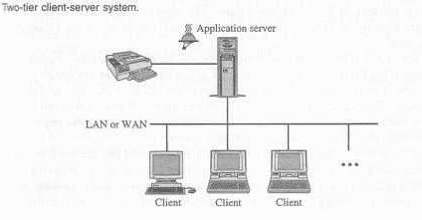
Client server computing
NOS provides services such as routing, distribution, messages, filing and printing.

Slide 66
Client server computing
The client is process (program) that sends a message to a server process.
Client program manage the user interface (GUI), dispatch request to server program, and execute business logic.
Server programs execute database retrieval and updates, manage data integrity and dispatch responses to client request.

Slide 67
Two-Tier Architecture
A two-tier architecture is one where a client talks directly to a server, with no intervening server.
This type of architecture is typically used in small environments with less than 50 users.

Slide 68
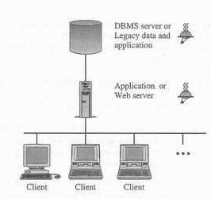
Three-Tier Architecture

Slide 69
Three-Tier Architecture
Three tier architecture introduces a server between the client and the server.
Web server/application server provides translation services, metering services, intelligent agent services.

Slide 70
Characteristics of Client-Server
Client interact with the user and a server interact with the shared resource.
Client process provide interface between user and rest of the application.
The front-end task and back-end task have fundamentally different requirements for computing resources. (memory, processor speed)
The environment is multivendor (different os, different hardware platform). The processes communicate through standard API.
Scalability (vertical and horizontal)
Horizontal – adding or removing client workstation
Vertical – migrating to a larger or faster server machine.

Slide 71
Client –server application components
A typical client-server application consist of the following components
User Interface – interacts with user, screens, windows, keyboard, mouse
Business processing – uses the user interface data to perform business tasks
Database processing – manipulate data within the application

Slide 72
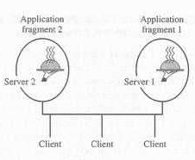
Distributed and cooperative processing
Distributed processing
Means distribution of application and business logic across multiple processing platforms.
Processing will occur on more than one processor in order for a transaction to be completed.

Slide 73
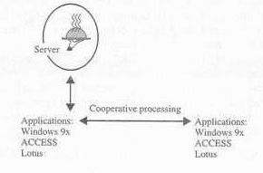
Distributed and cooperative processing
Cooperative processing
Requires two or more distinct processors to complete a single transaction.
Is a form of distributed computing requires two or more distinct processors.
Communication between processors in the form of message passing.

Slide 74
Object Oriented Database Management System

Slide 75
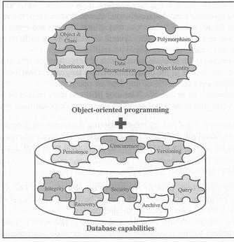
Object-Oriented Database Systems
The object-oriented database management system is a marriage of object-oriented programming and database technology to provide what we now call object-oriented databases.

Slide 76
Object oriented database characteristics
The rules that make it an object-oriented system are as follows:
The system must support complex objects.
Object identity must be supported.
Objects must be encapsulated.
The system must support types or classes.
The system must support inheritance.
The system must avoid premature binding.
The system must be computationally complete.
The system must be extensible.

Slide 77
Object oriented database characteristics
Second, these rules make it a DBMS:
9. It must be persistent, able to remember an object state.
10. It must be able to manage very large databases.
11. It must accept concurrent users.
12. It must be able to recover from hardware and software failures.
13. Data query must be simple

Slide 78
Object oriented vs traditional databases
Object oriented
Traditional
Allow for sharing, concurrent multiuser access
Objects ability to interact with other objects
Objects are active component
Support Inheritance
Storage of data in the form of objects
Each object has an object-id
Manage large number of different data type, relationship between objects, object with complex behaviors.
Allow for sharing, concurrent multiuser access
--
Records play a passive role.
Don’t explicitly support inheritance

Slide 79
Object Oriented databases
GemStone/S →GemStone/S is an object database system based on Smalltalk – an object-oriented programming language influenced by Java.
ObjectDB →ObjectDB is a NoSQL object database for the Java programming language.
ObjectDatabase++ → ObjectDatabase++ is a real-time embeddable object database designed for server-side applications.
Objectivity/DB → Objectivity/DB utilizes the power of objects and satisfies the complex requirements within Big Data.
ObjectStore → ObjectStore integrates with C++ or Java and provides memory persistency to improve the performance of application logic.
Versant - Versant provides primary transparent object persistence from C++, Java, and .NET.

Slide 80
Object Relational Systems
A mapping tool for mismatch between the programming model and existing relational database layout.
Reverse engineering : creating an object model from an existing relational database layout (schema)
Forward engineering : creating a relational schema from an existing object model.
Forward and reverse engineering combined in an iterative process.
Tools that define the relationship between the table structure (schema) with classes in object model.
Ex. Sun’s java blend

Slide 81
Object-Relation Mapping
A tuple (row) of a table contains data for a single entity that correlates to an object.(instance of a class) in an object oriented system.
Stored procedure in a relational database may correlate to a method in an object oriented architecture.
Tool used to define the relational data maps to and from application objects. The following are two way mapping
Table-class mapping
Table-multiple class mapping
Table-inherited class mapping
Tables-inherited class mapping
Table | Class
Row | Object
Column | Attribute
Stored procedure | method

Slide 82
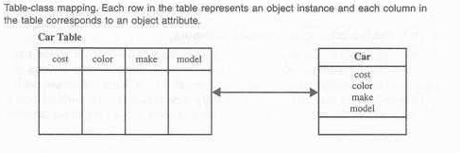
Table-class Mapping
Is a simple one-to-one mapping of a table to a class and the mapping of columns in a table to properties in a class
To map all the columns to properties.
In this mapping, a single table is mapped to a class single class.

Slide 83
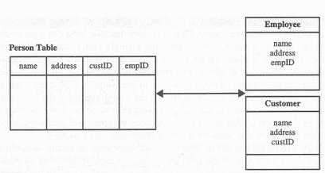
Table-Multiple Classes Mapping
A single table maps to multiple noninheriting classes. Two or more distinct , non inheriting classes have properties that are mapped to columns in a single table.
custID column provides the discriminant. If the value for custID is null, an Employee instance is created at run time; otherwise a Customer instance is created.

Slide 84
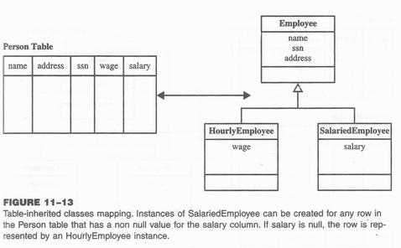
Table-inherited class mapping
A single table maps to many classes that have a common super class.
This mapping allows the user to specify the columns to be shared among the related classes.

Slide 85
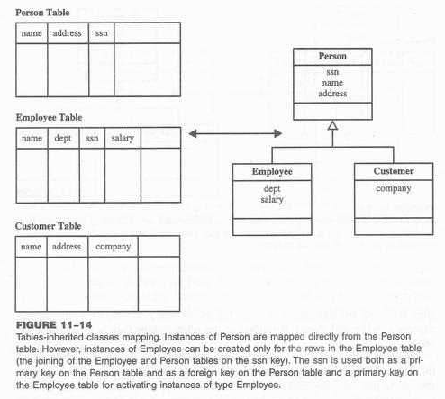
Tables-Inherited Classes Mapping
Allows the translation of is-a relationships that exist among tables in the relational schema into class inheritance relationship in the object model.
Is-a relationship is modeled by a primary key that act as a foreign key to another table.

Slide 86
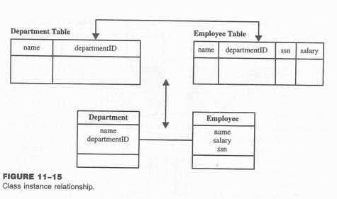
Tables-Inherited Classes Mapping
Each employee instance has a direct reference of class Department (association) to the department object to which it belongs

Slide 87
View Layer: Designing View Layer Classes

Slide 88
UI Design
The main goal of a user Interface (UI) is to display and obtain needed information in an accessible, efficient manner.
A well designed interface has visual appeal that motivates users to use your applications.
GUI design is a creative process
A curious and imaginative mind
A broad background and fundamental knowledge of existing tools.
Discovering solution once a problem has been defined.
Being able to deal with ambiguity and uncertainity

Slide 89
Design a view layer classes
View layer objects are responsible for two major aspects
1.Input – responding to user interaction
clicking on a button or selecting a menu
2. Output – displaying or printing business objects

Slide 90
Design a view layer classes
Design of the view layer classes are divided into the following activities:
I. Macro Level UI Design Process- Identifying View Layer Objects.
II. Micro Level UI Design Activities.
– Designing the view layer objects by applying design axioms
– Prototyping the view layer interface
III. Usability and User Satisfaction Testing.
IV. Refine and Iterate.

Slide 91
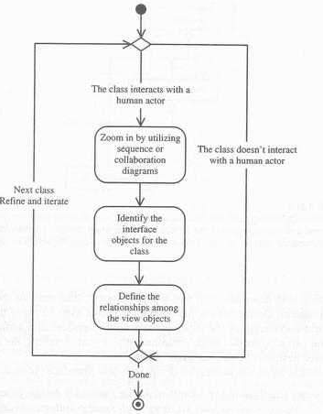
Macro-Level Process – Analyzing view classes By analyzing usecases
1. For Every Class Identified, Determine If the Class Interacts With Human Actor: If yes, do next step, otherwise move to next class.
1.1 Identify the View (Interface) Objects for The Class.
1.2 Define Relationships Among the View (Interface) Objects.
2. Iterate and refine

Slide 92
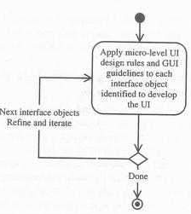
Micro Level Process
Better to design the view layer objects user driven or user centered
Process of designing view objects
For Every Interface Object Identified in the Macro UI Design Process.
1.1 Apply Micro Level UI Design Rules and Corollaries to Develop the UI.
2. Iterate and refine.

Slide 93
UI Design Rules
Rule 1- Making the Interface Simple
Rule 2- Making the Interface Transparent and Natural
Rule 3- Allowing Users to Be in Control of the Software

Slide 94
UI Design Rule 1
Making the interface simple: application of corollary 2.
Keep It Simple.
Simplicity is different from being simplistic.
Making something simple requires a good deal of work and code.
Every additional feature potentially affects performance, complexity, stability, maintenance, and support costs of an application.
A design problem is harder to fix after the release of a product because users may adapt, or even become dependent on, a peculiarity in the design.

Slide 95
UI Design Rule 2
Making the interface transparent and Natural: application of corollary 4.
Corollary 4 implies that there should be strong mapping between the user's view of doing things and UI classes.
Making The Interface Natural
The user interface should be intuitive so users can anticipate what to do next by applying their previous knowledge of doing tasks without a computer.
Using Metaphors
Metaphor, relates two unrelated things by using one to denote the other Metaphors can assist the users to transfer their previous knowledge from their work environment to your application interface.
For example, question mark to label a Help button.

Slide 96
UI Design Rule 3
Allowing users to be in control of the software: application of corollary 1.
Users should always feel in control of the software, rather than feeling controlled by the software.
Allowing Users Control of the Software. Some of the ways to put users in control are:
Making the Interface Forgiving
Users should be able to back up or undo their previous action.
They should be able to explore without fear of causing an irreversible mistake.
Making the Interface Visual
You should make your interface highly visual so users can see, rather than recall, how to proceed.
Whenever possible, provide users with a list of items from which they can choose.
Providing Immediate Feedback
Users should never press a key or select an action without receiving immediate visual feedback, audible feedback, or both.
Making the Interface Consistent
User Interfaces should be consistent throughout the applications.
For example, keeping button locations consistent make users feel in control.

Slide 97
Purpose of View Layer Interface
Purpose of a View Layer Interface
Data Entry Windows: Provide access to data that users can retrieve, display, and change in the application.
Dialog Boxes: Display status information or ask users to supply information.
Application Windows (Main Windows): Contain an entire application that users can launch.

Slide 98
Guidelines For Designing Data Entry Windows
You can use an existing paper form such as a printed invoice form as the starting point for your design.
If the printed form contains too much information to fit on a screen:
Use main window with optional smaller Windows that users can display on demand, or Use a window with multiple pages.
Users scan a screen in the same way they read a page of a book, from left to right, and top to bottom.
An example of a dialog box with multiple pages in the Microsoft multimedia setup.

Slide 99
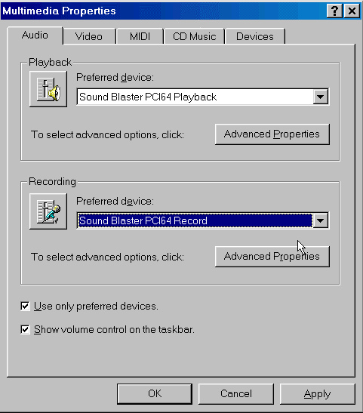
Guidelines For Designing Data Entry Windows

Slide 100
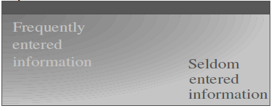
Orient the controls in the dialog box in the direction people read.
Usually left to right, top to bottom.
Required information should be put toward the top and left side of the form, entering
optional or seldom entered information toward the bottom.

Slide 101
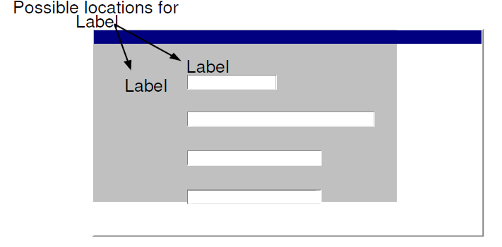
Place text labels to the left of text box controls, align the height of the text with text displayed in the text box.

Slide 102
Guidelines For Designing Dialog Boxes
If the dialog box is for an error message, use the following guidelines:
Your error message should be positive.
For example instead of displaying “You have typed an illegal date format,” display this
message “Enter date format mm/dd/yyyy.”
Your error message should be constructive, brief and meaningful.
For example, avoid messages such as “You should know better! Use the OK button”
instead display “Press the Undo button and try again.”

Slide 103
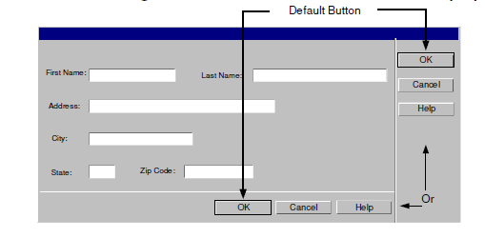
Guidelines For The Command Buttons Layout
Arrange the command buttons either along the upper-right border of the form or dialog box or lined up across the bottom.
Positioning buttons on the left or center is popular in Web interfaces.

Slide 104
Guidelines For Designing Application Windows
A typical application window consists of a frame (or border) which defines its extent: title bar, scroll bars,menu bars, toolbars, and status bars.
Guidelines For Using Colors
Use identical or similar colors to indicate related information.
Use different colors to distinguish groups of information from each other.
For example, checkout and in-stock tapes could appear in different colors.
For an object background, use a contrasting but complementary color.
For example, in an entry field, make sure that the background color contrasts with the data color
Use bright colors to call attention to certain elements on the screen.
Use dim colors to make other elements less noticeable.

Slide 105
Guidelines For Designing Application Windows
For example, you might want to display the required field in a brighter color than optional fields.
Use colors consistently within each window and among all Windows in your application.
For example the colors for Pushbuttons should be the same throughout.
Using too many colors can be visually distracting, and will make your application less interesting.
Allow the user to modify the color configuration of your application.

Slide 106
Guidelines For Using Fonts
Use commonly installed fonts, not specialized fonts that users might not have on their machines.
Use bold for control labels so they will remain legible when the object is dimmed.
Use fonts consistently within each form and among all forms in your application.
For example, the fonts for check box controls should be the same throughout.
Consistency is reassuring to users, and psychologically makes users feel in control.
Using too many font styles, sizes and colors can be visually distracting and should be avoided.

Slide 107
Prototyping the User Interface
Rapid prototyping encourages the incremental development approach, “grow, don’t build.”
Three General Steps
Create the user interface objects visually.
Link or assign the appropriate behaviors or actions to these user interface objects and their events.
Test, debug, then add more by going back to step 1.

Slide 108
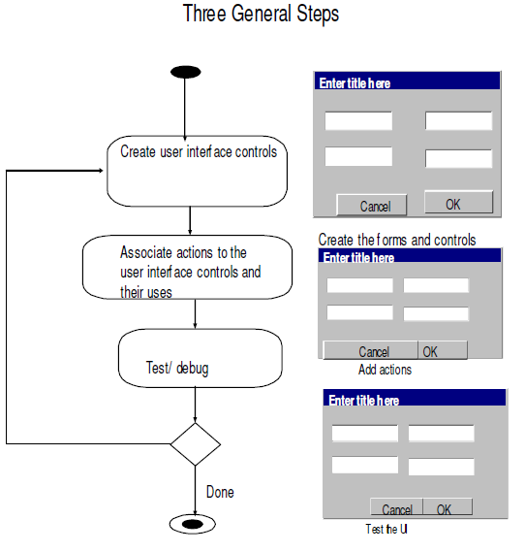
Prototyping the User Interface

Slide 109
Thank You

